Slide 1
operators
Unit-II

Slide 2
Operators in Oracle
Arithmetic Operators
Logical Operators
Range Search Operators
Pattern Matching Operators
Relational operators

Slide 3
Arithmetic Operators
+ Addition
- Subtraction
/ division
* Multiplication
** Exponentiation
() Enclosed operation

Slide 4
Arithmetic operators example
Select ename , sal+comm, sal-comm, sal*12 from emp;
Select ename, sal, sal+(sal*.2)’gross_sal’ from emp;

Slide 5
Range Searching
Between:-To select data within a range of values between operator is used . It can be used for numeric and character data.
Example:-
Select ename, sal, comm from emp Where deptno=10 or deptno=20

Slide 6
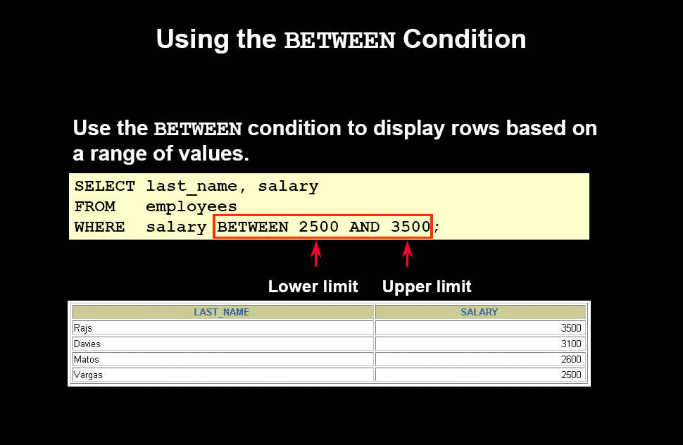
Range search Example

Slide 7
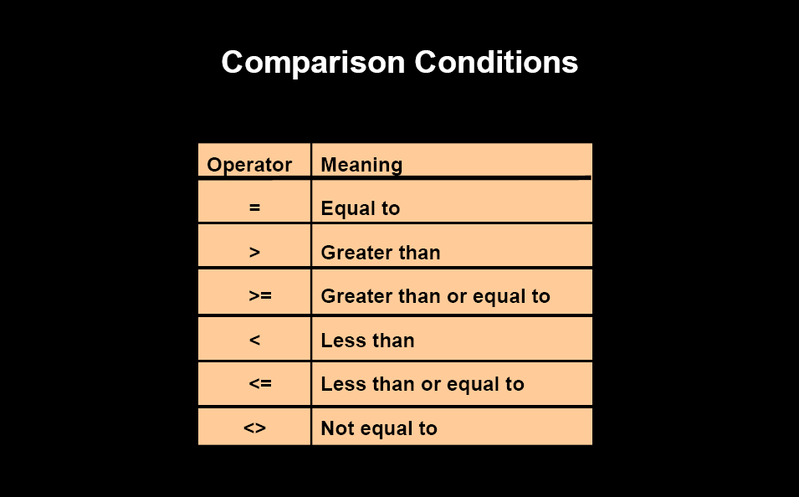
Relational operators

Slide 8
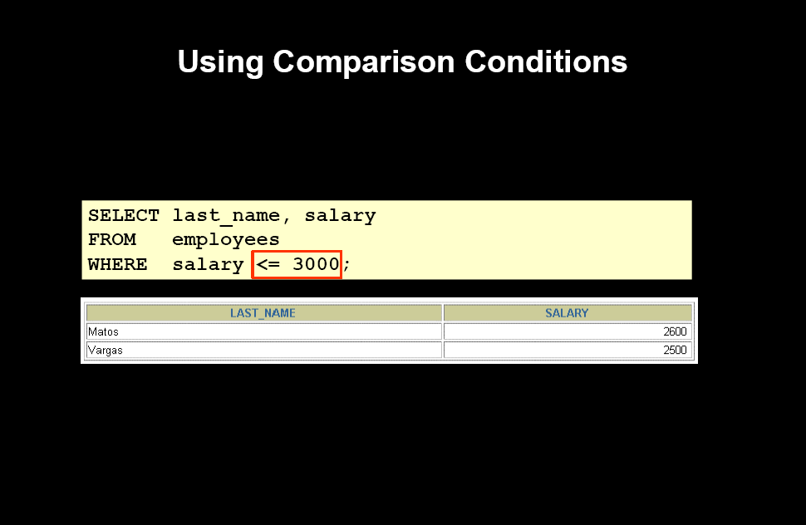

Slide 9
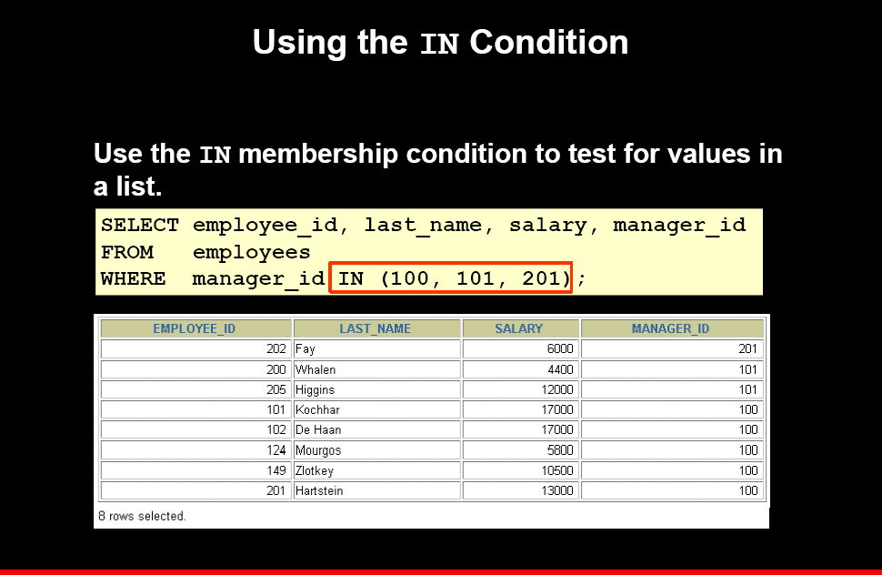

Slide 10
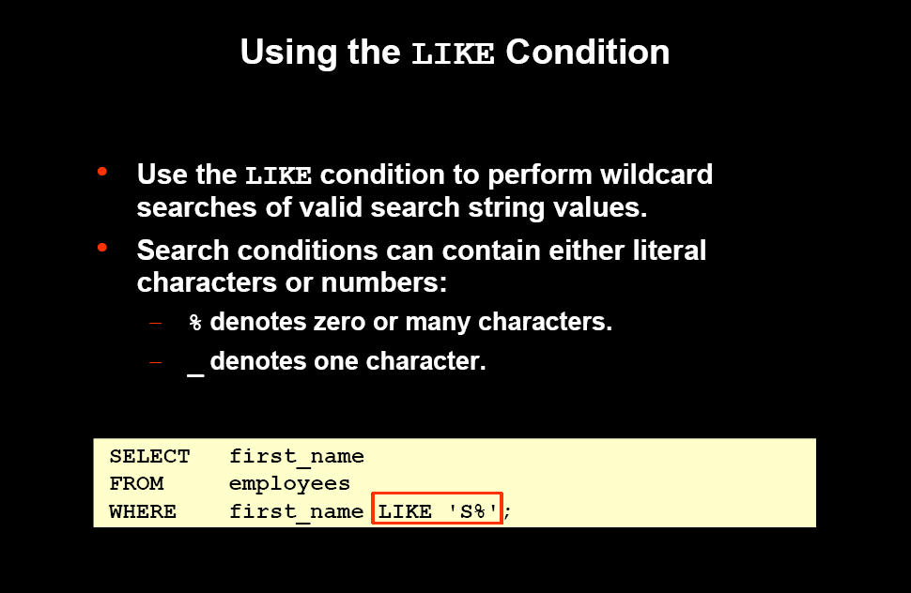
Pattern Matching

Slide 11
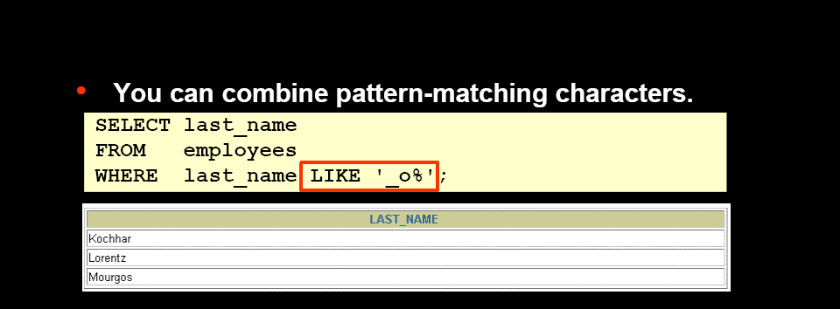

Slide 12
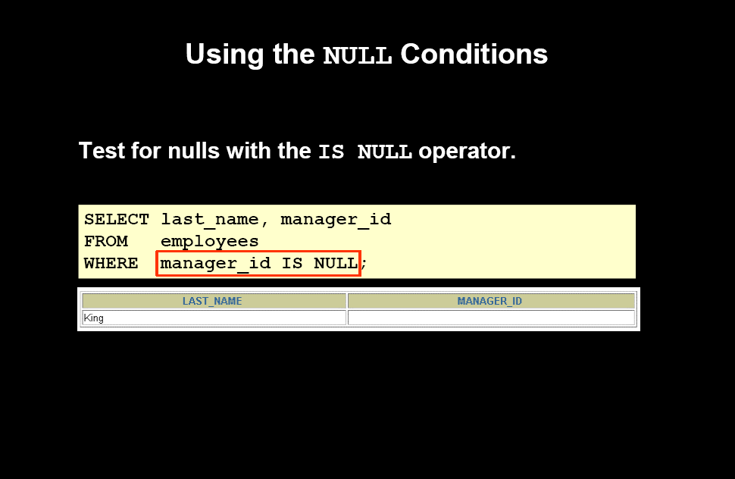

Slide 13
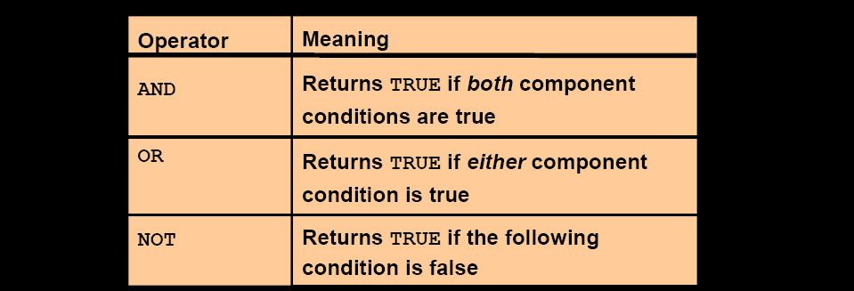
Logical operators

Slide 14
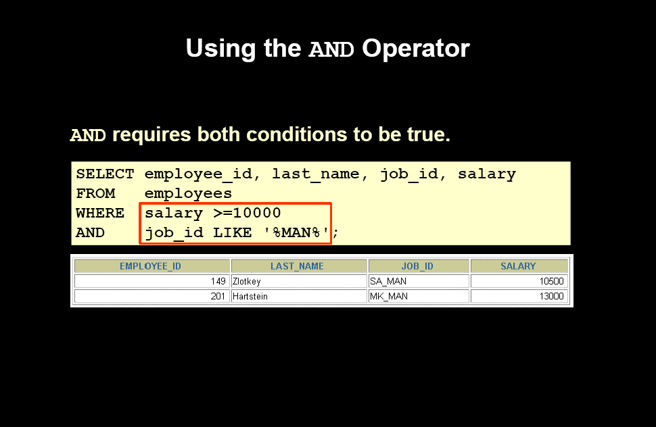

Slide 15
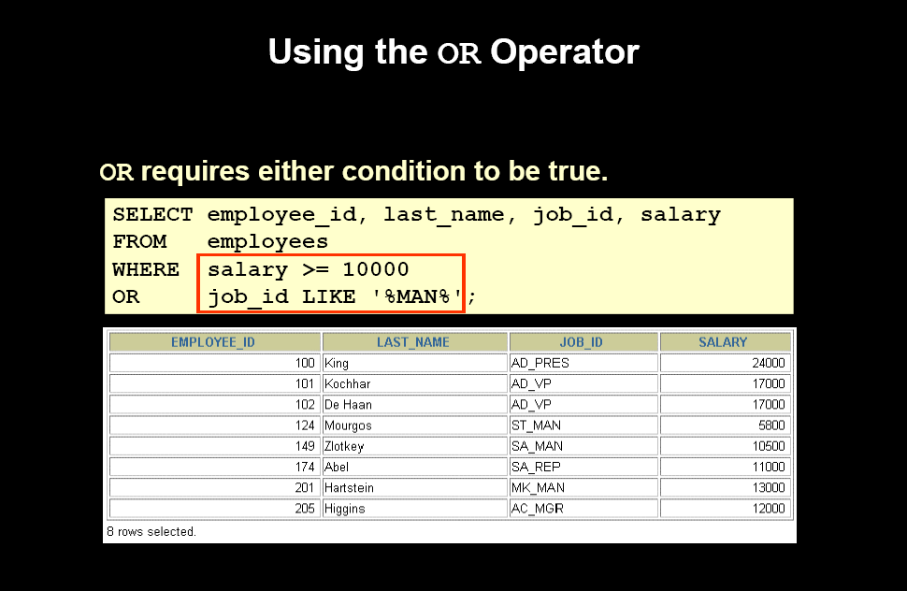

Slide 16
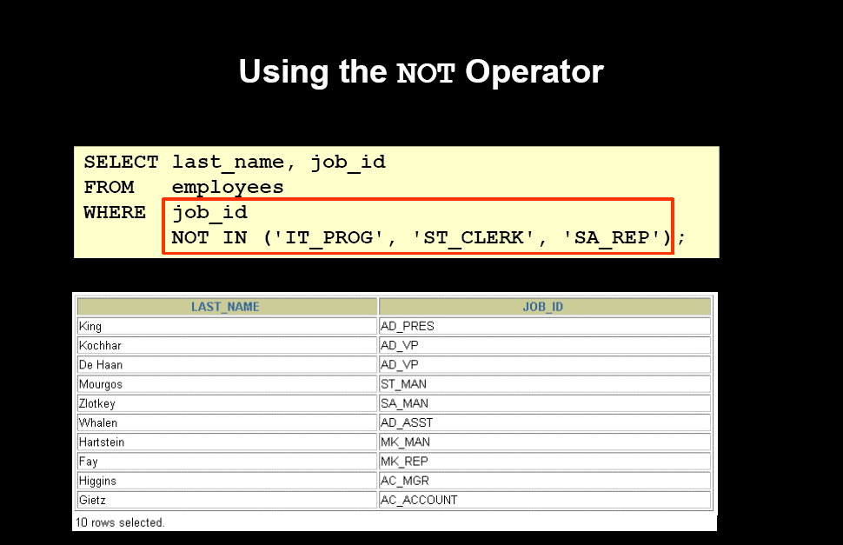

Slide 17
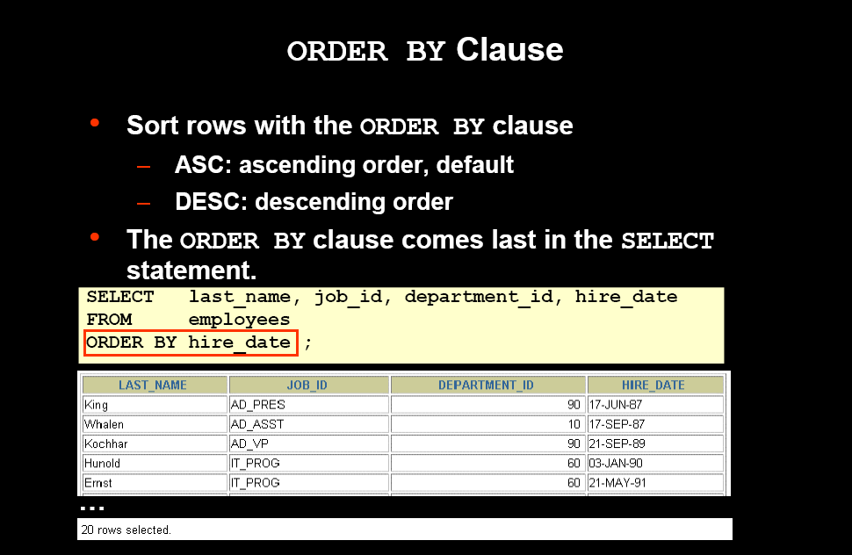

Slide 18
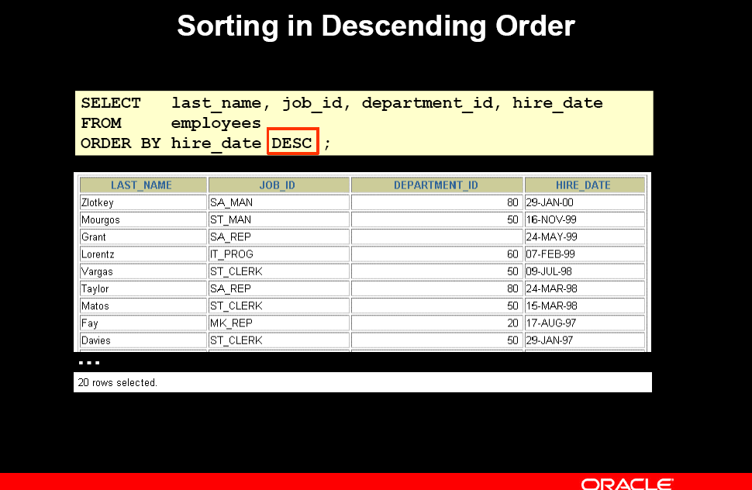

Slide 19
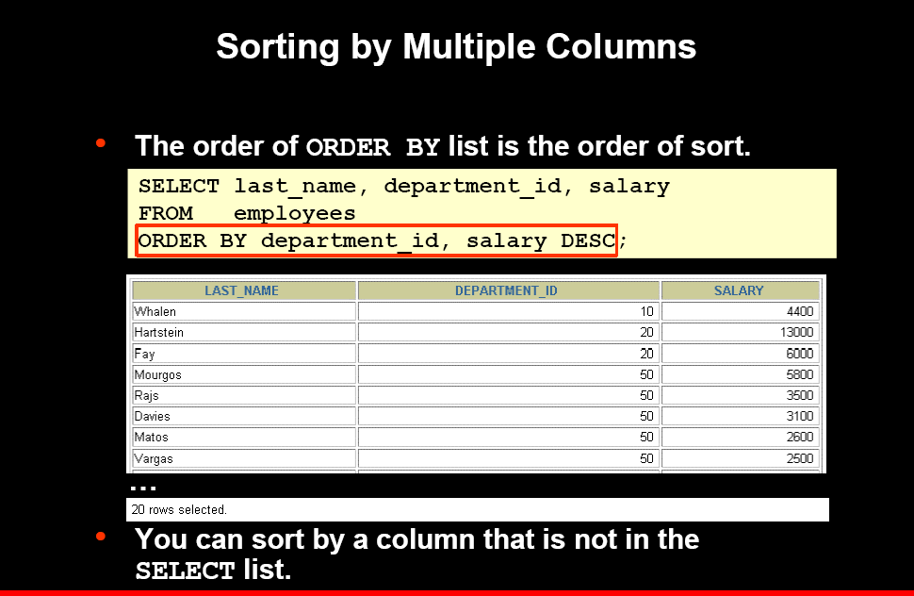

Slide 20
Set operators
These operators are used to combine the result of more than one query & produce final result.
There are 4 set operators
Union
Union all
Intersect
Minus

Slide 21
Common rules on set operators
Number of column in all queries must be same along with same order and data type.
We can not have order by clause associated with individual queries but only after last query.

Slide 22
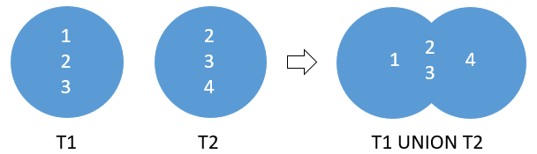
we have two tables T1 and T2: T1 has three rows 1, 2 and 3 T2 also has three rows 2, 3 and 4
the UNION operator is a set operator that combines result sets of two or more SELECT statements into a single result set.
The UNION removed the duplicate rows 2 and 3

Slide 23
Union
It returns the record of all queries without displaying any record more than once.
Example
Display jobs from all three departments 10,20,30 without any repeated values.
Select job from emp where deptno=10
Union
Select job from emp where deptno in(20,30)order by job;

Slide 24
Union all
It return all the record from all the queries.
Example
select job from emp where deptno=10
union all
select Job from emp where deptno=20 order by job;
JOB
---------
ANALYST
ANALYST
CLERK
CLERK
CLERK
MANAGER
MANAGER
PRESIDENT

Slide 25
Intersect
Returns common record from queries.
Select job from emp where deptno=10
Intersect
Select job from emp where deptno=20
Intersect
Select job from emp where deptno=30;
JOB
---------
CLERK
MANAGER

Slide 26
Minus
Return record of first query after eliminating matching
record with second query.
Example
Select job from emp where deptno=10
Minus
Select job from emp where deptno=20;
JOB
---------
PRESIDENT

Slide 27
Example of Minus
Select job from emp where deptno=20
Minus
Select job from emp where deptno=10
JOB
---------
ANALYST

Slide 28
Table and Columns Aliases
ALIASES are temporary names given to columns or tables
Oracle ALIASES can be used to create a temporary name for columns or tables.
COLUMN ALIASES are used to make column headings in your result set easier to read.
TABLE ALIASES are used to shorten your SQL to make it easier to read or when you are performing a self join (ie: listing the same table more than once in the FROM clause).

Slide 29
The syntax to ALIAS A COLUMN in Oracle/PLSQL is:
SQL Aliases are defined for columns and tables. Basically aliases is created to make the column selected more readable.
For Example: To select the first name of all the students, the query would be like:
Aliases for columns:
select ename as name from emp;
SELECT first_name AS Name FROM student_details;

Slide 30
Aliases is more useful when
There are more than one tables involved in a query,
Functions are used in the query,
The column names are big or not readable,
More than one columns are combined together

Slide 31
Aliases for tables:
select s.deptno from emp s;
SELECT s.first_name FROM student_details s;

